Slide 1
Brain Tumor Segmentation Using Convolutional Neural Networks in MRI Images
Ashish Nehra(2019IMT-022)
Under Supervision of
Dr. Binod Prasad
ABV-IIITM Gwalior
Gwalior- 474015, MP, India
27 March, 2022

Slide 2
Outline
Introduction
Project Objectives
Material and Research Flow
Methodology and Implementation Details
Results
Conclusion
References

Slide 3
Diagnostic Methods
Techniques
Performing
Biopsy
Performing
Imaging
Ultra sounds
X-Rays
CT
MRI

Slide 4
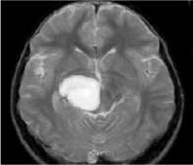
Introduction
The BRAIN is the most important part of central nervous system
Brain tumor at early stage is very difficult task for doctors to identify. MRI images are more prone to noise and other environmental interference. So manual segmentation is time-consuming and subjected to inter- and intra-rater errors difficult to characterize.
The only optimal solution for this problem is the use of ‘Image Segmentation’.
Figure: MRI showing tumor in brain

Slide 5
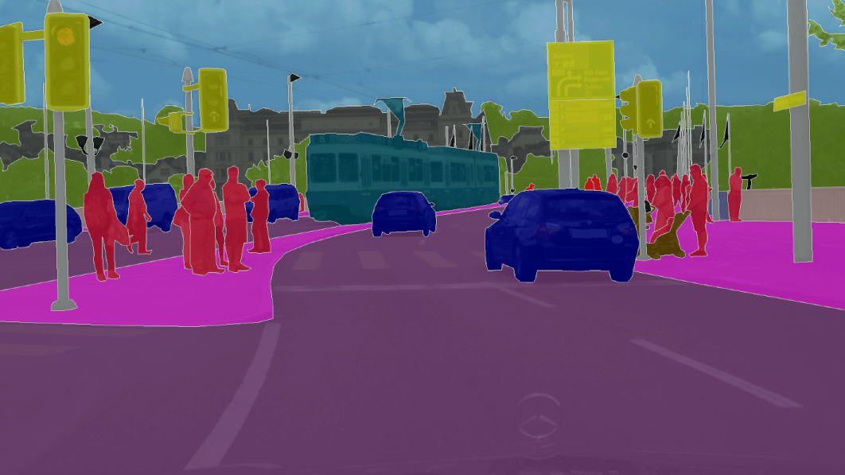
Image Segmentation
The purpose of image segmentation is to partition an image into meaningful regions with respect to a particular application.
The segmentation might be grey level, colour, texture, depth or motion.

Slide 6
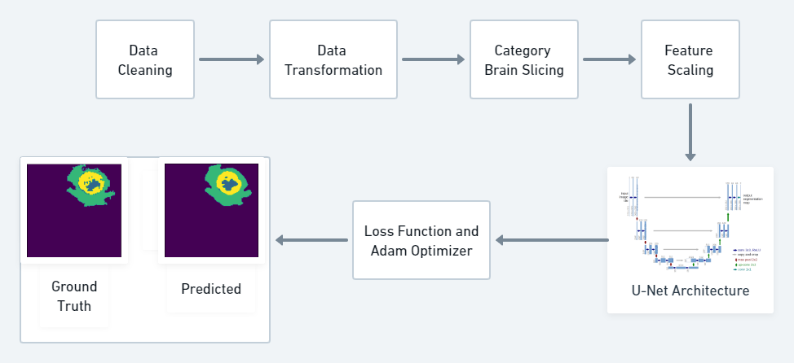
Methodology

Slide 7
Implementation Details
Converted all types of images in NumPy array
Combined t1ce, t2 and flair images in one image
Cropped images removing redundant area in image
Defined U-Net Model using Conv3D, Dropout and MaxPooling3D layers.
Applied Loss Function(dice loss + focal loss), Adam Optimizer(LR=0.0001) and accuracy metric as IoUScore(threshold = 0.5).
Predicting the Mean IoU Score on Validation Data.
Visualizing the Result.

Slide 8
Future Scope
As Medical image segmentation plays a very important
role in the field of image guided surgeries.
By creating Three dimensional (3D) anatomical models from individual patients, training, planning, and computer guidance during surgery is improved.

Slide 9
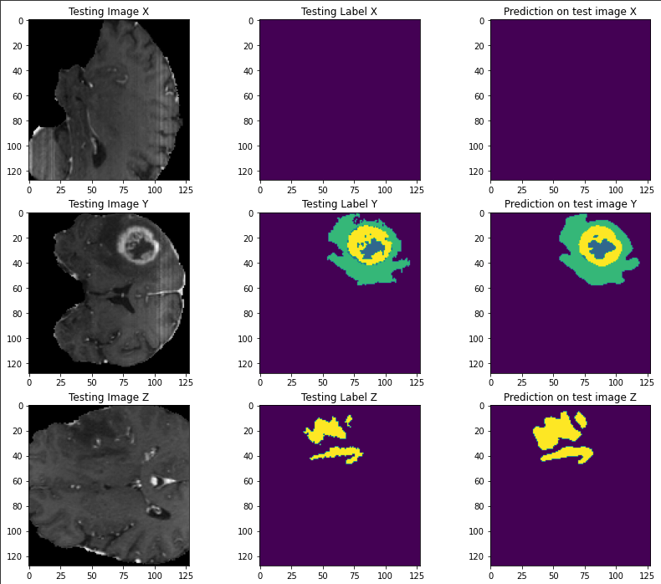

Results
Mean IoU Score on Validation Dataset

Slide 10
References
https://ieeexplore.ieee.org
https://www.sciencedirect.com
https://analyticsindiamag.com

Slide 11
Thank You

